Slide 1
Vertically Sliced .NET Serverless Lambdas:
The Made-for-TV Movie

Slide 2

About Garo Yeriazarian (@garoyeri)
[Gaw-row Yeah-ree-uh-zaw-ree-uh-n]
14 YEARS AT BAKER HUGHES
Software Engineer, Manager, Design Chair, Software Whisperer
1.92 YEARS AT HEADSPRING
Principal Consultant (Software Whisperer)
LIKES
DevOps, Containerization, Bad Puns, Romantic Comedies, Good Coffee
DISLIKES
Leaders who don’t “Own their Experience”, “That’s the way we’ve always done it”, Bad Coffee

Slide 3
Big Goals
What is “Serverless”
What you need to know about AWS
Deploy from Visual Studio
Discuss the Next Steps

Slide 4

“Serverless”

Slide 5

Spoilers

Slide 6
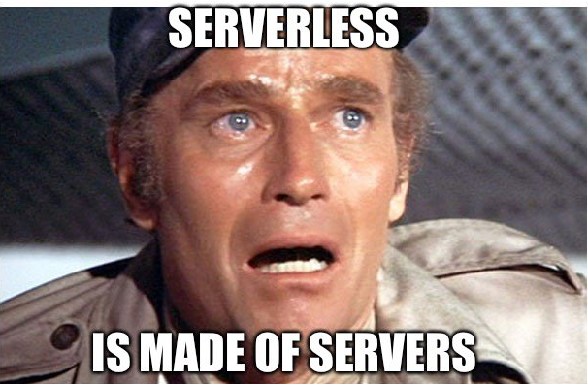

Slide 7
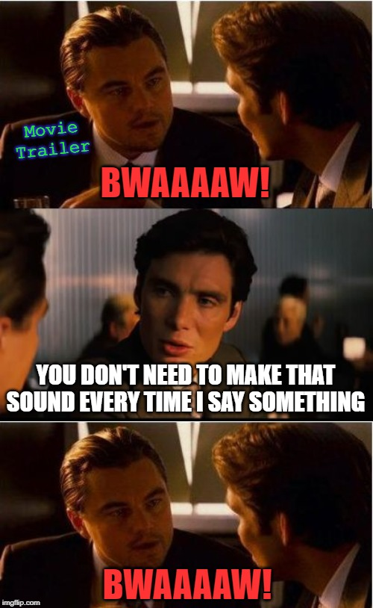

Slide 8
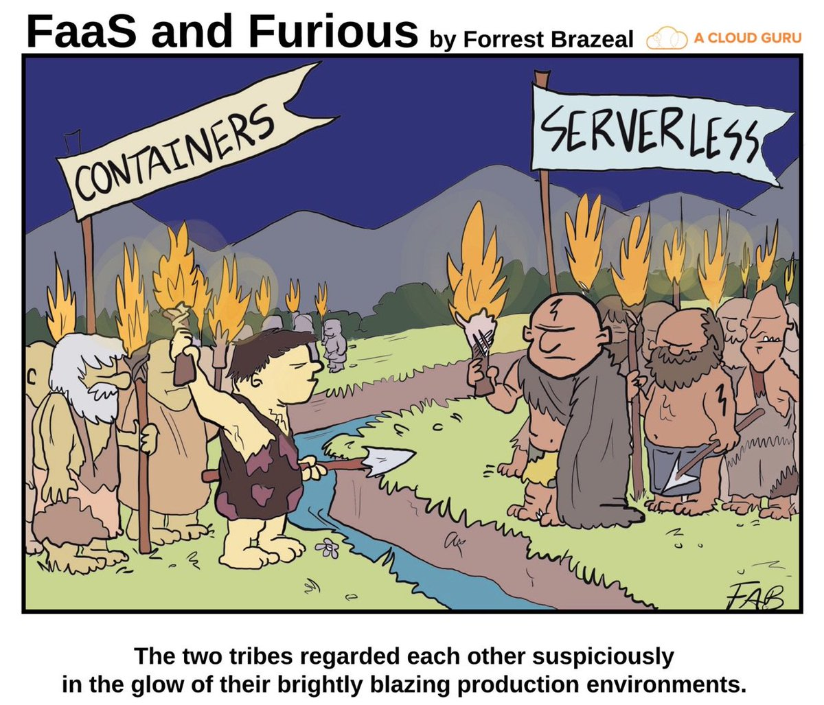

Slide 9
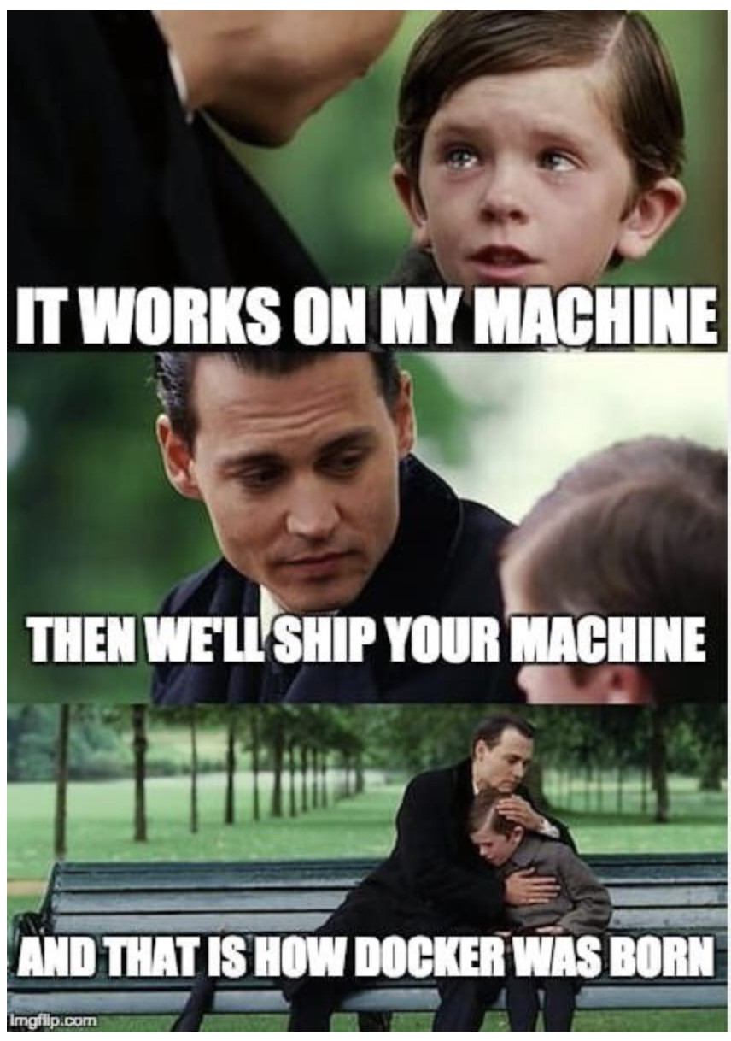

Slide 10
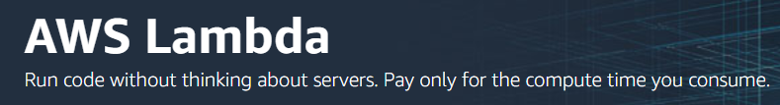
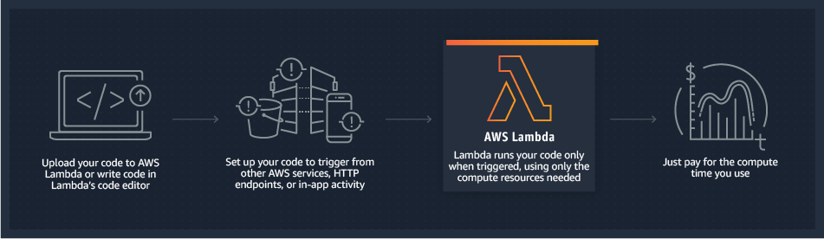

Slide 11

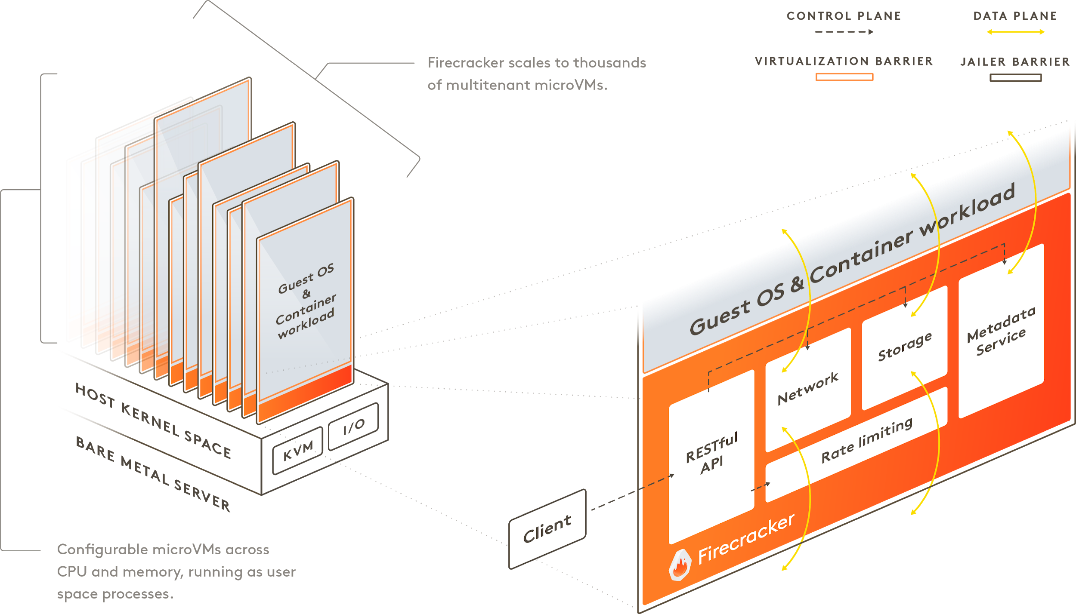
https://firecracker-microvm.github.io/

Slide 12

Amazon Web Services

Slide 13


Slide 14
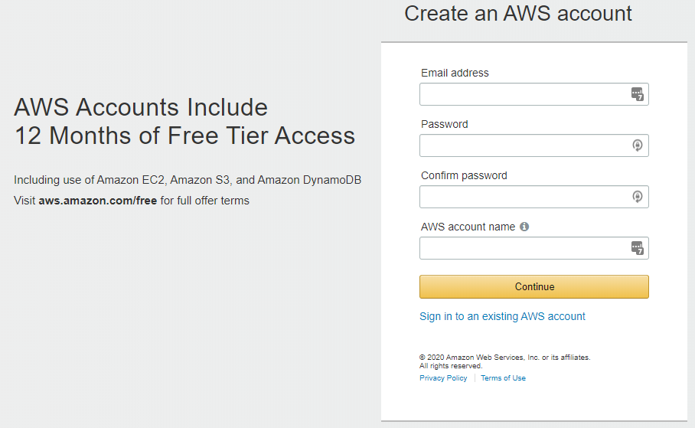
Create an Account (Free Tier for 12 Months)

Slide 15
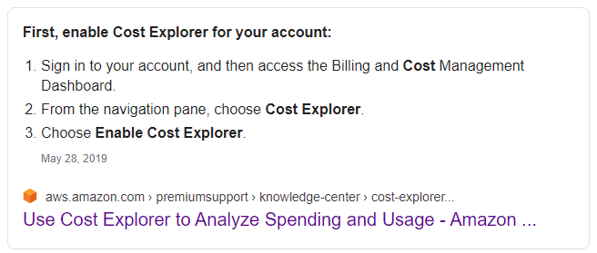
Enable Cost Explorer
It will take 24 hours for data to start showing up, but you can then see daily cost breakdowns for all service usage

Slide 16
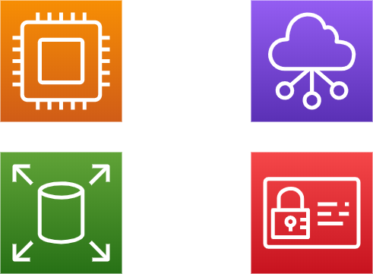
AWS Services Core Components
Compute
Network
Storage
Permissions

Slide 17


Slide 18

AWS Services Permissions
“Circle” of Trust!
Caller Permissions
Callee Permissions
Lambda
Role
Permission
S3

Slide 19

Deploy from Visual Studio

Slide 20
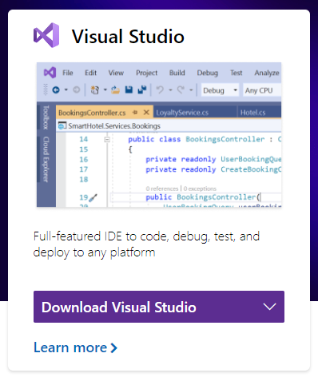
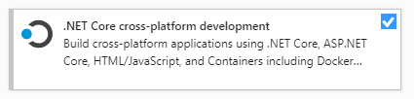
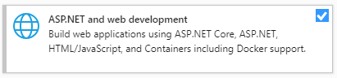
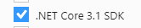
This is the .NET User Group, so …
2019 required! (Community version is OK!)
https://visualstudio.microsoft.com/

Slide 21
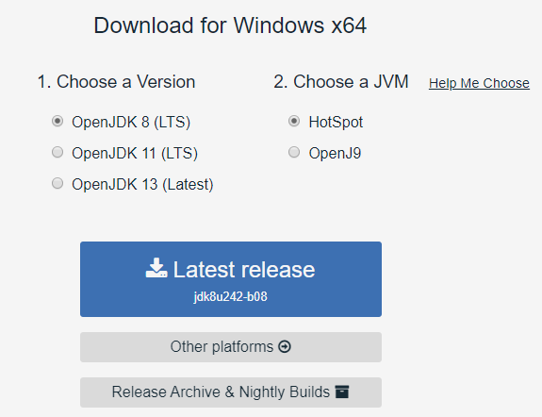
Install a Java Runtime Environment
https://adoptopenjdk.net/
We’ll use this to setup a DynamoDB locally

Slide 22
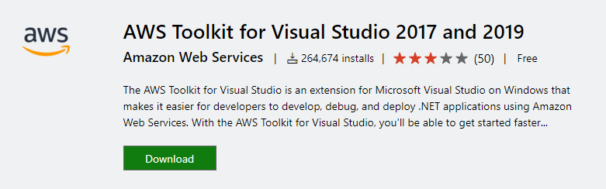
AWS Toolkit for Visual Studio
https://marketplace.visualstudio.com/items?itemName=AmazonWebServices.AWSToolkitforVisualStudio2017

Slide 23
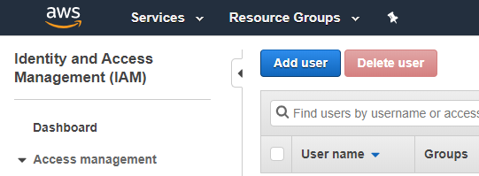
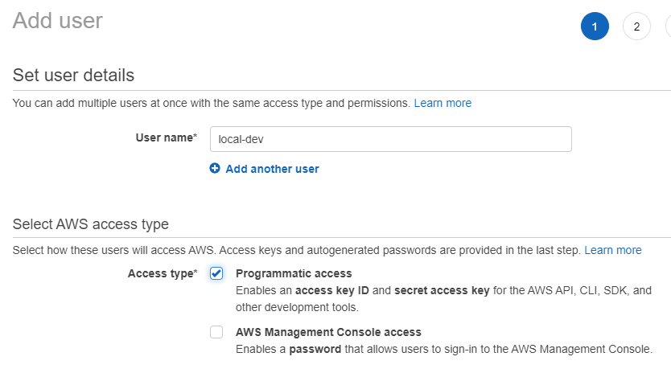
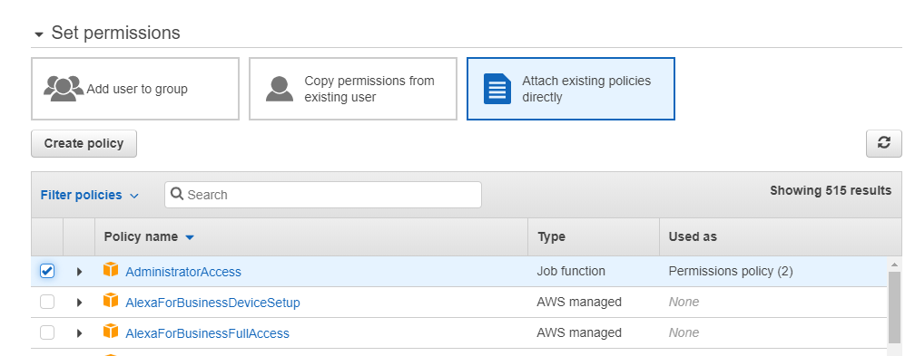
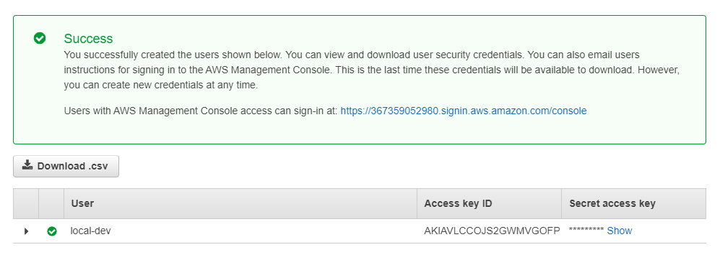
Create an IAM User for Local Use

Slide 24
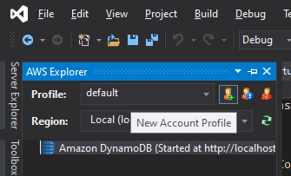
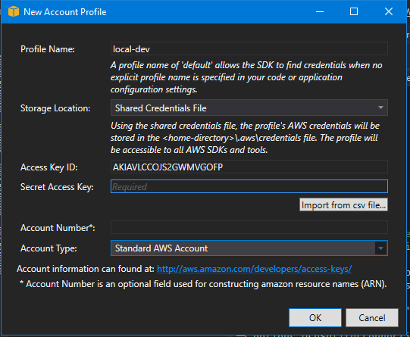
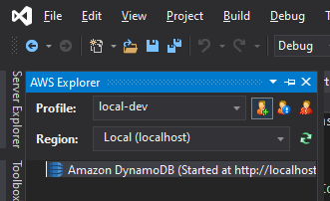
Add Profile to Visual Studio

Slide 25
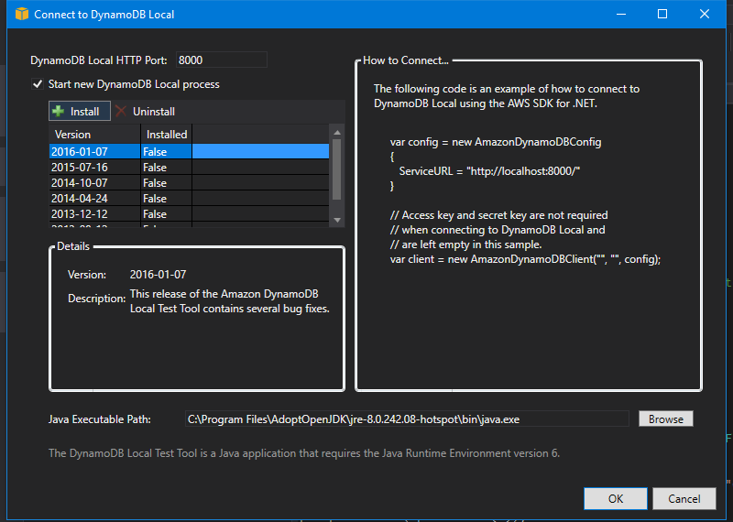
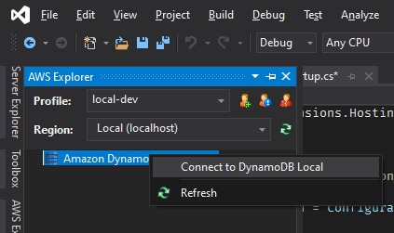
Start Local DynamoDB

Slide 26
Demo(lition)

